Slide 1
PM-SRA&D Coursework
Project Design

Slide 2
Overall Project Design
Feasibility Report – Project Proposals
Overall Project Plan
Project Implementation (including plan and analysis of requirements and design phases)
Requirements Changes
Project Test Plan
Project Deployment Plan
Project Training Plan
Project Summary

Slide 3
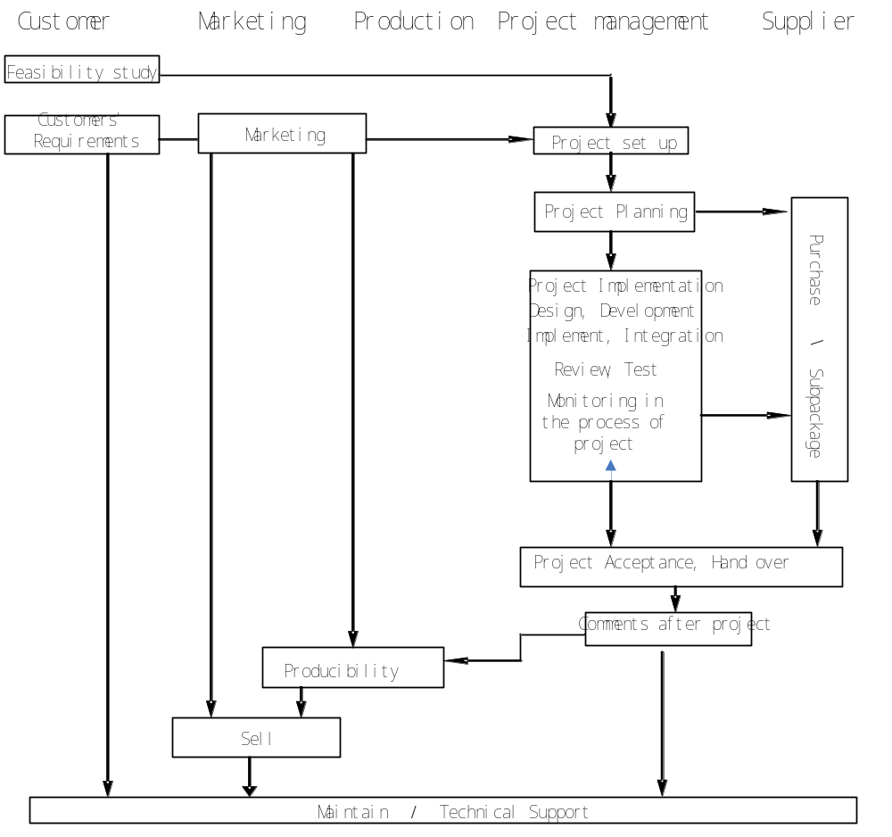
Project Management Process

Slide 4
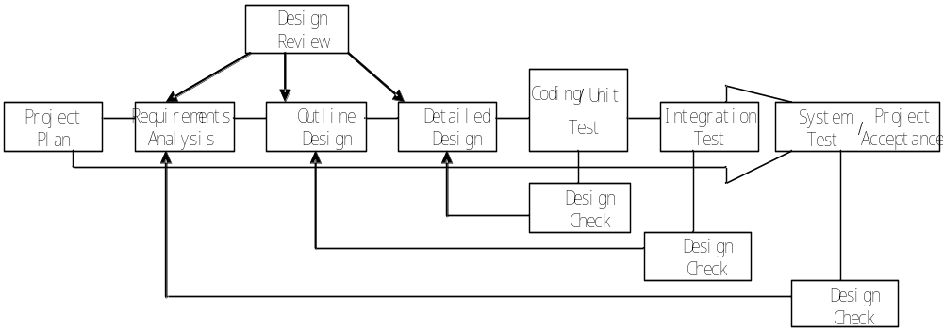
Project Implementation Process

Slide 5
Configuration Management Requirements
Project Team ID (project team subdirectory)
Project ID (project subdirectory)
Participants
  Project manager
  Developers
    including system analysts, programmers, technical support engineers.
  Configuration manager
Process of main activities
  Identification configuration
  Version control
  change Control
Uncontrolled Documents (1st-level subdirectory)
Controlled Documents (1st-level subdirectory)
Analysis Design (2nd-level subdirectory)
File 1
File n
Coding (2nd-level subdirectory)
Program Unit 1 (3rd-level subdirectory)
Source Code
Program Unit 2 (3rd-level subdirectory)
Source Code
Test (2nd-level subdirectory)
Product (2nd-level subdirectory

Slide 6
Project Requirements
Details in
  Coursework Requirement
  Project Description

Slide 7
Process and Check
Periodicity check, submission in the form of report

Slide 8
Submission Form of the Completion of Project
Documents and necessary process attachments used to implement the result analyzed in documents.
Project presentation
Instructions of system implementation and detailed system configuration.

